Slide 1

Managing DATA WITH POWERSHELL
DATA ANZ Australia
Patrick Flynn
SQL Server DBA
Mercer Australia

Slide 2



SPONSORS
Telstra Purple
Sirius Technology
Databricks
https://purple.telstra.com
https://siriuspeople.com.au
https://databricks.com

Slide 3
Code of conduct
Be aware of others
Be friendly and patient
Be welcoming and respectful
Be open to all questions and viewpoints
Be understanding of differences
Be kind and considerate to others
Data ANZ seeks to provide a respectful, friendly professional experience for everyone, regardless of gender, sexual orientation, physical appearance, disability, age, race or religion.
We do not tolerate any behaviour that is harassing or degrading to any individual, in any form. Individuals are responsible for knowing and abiding by these standards. We encourage everyone to assist in creating a welcoming and safe environment.

Slide 4
Demo Time
ImportExcel
DBATools
PSFramework
PowershellAI

Slide 5

@sqllensman
https://github.com/sqllensman

Slide 6
Links
dbatools – the community's sql powershell module
Welcome to the PowerShell Framework | The project dedicated to empowering your PowerShell scripting. (psframework.org)
dfinke/ImportExcel: PowerShell module to import/export Excel spreadsheets, without Excel (github.com)
dfinke/PowerShellAI: PowerShell AI module for OpenAI GPT-3 and DALL-E (github.com)

Slide 7
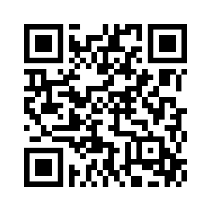
THANK YOU
DATA ANZ Australia
Patrick Flynn
sqllensman@outlook.com
Feedback Form

